Slide 1
MySQL’s Concrete Architecture (Query Processor)
Tabs vs. Spaces
Varsha Ragavendran
Nisha Sharma
Davood Anbarnam
Ayman Abualsunun
Anton Sitkovets
Glib Sitiugin
Kevin Arindaeng
Notes:
10 sec max

Slide 2
Introduction
Query Processor is within the Logical Layer of MySQL
Processes queries
Determines how to execute the query
Query must be semantically and syntactically valid
Executes the Query in optimized manner
Notes:
1 min (Intro + Overview)

Slide 3
Overview
Derivation Process
System Architecture
Overall Query Processor Architecture Analysis
Subsystem Analysis
Use Cases
Conclusions
Lessons Learned
Notes:
1min: Varsha (Intro + Overview)

Slide 4
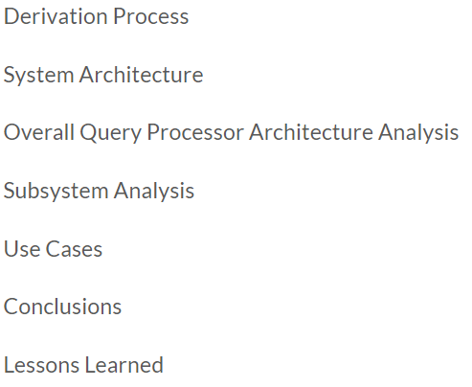
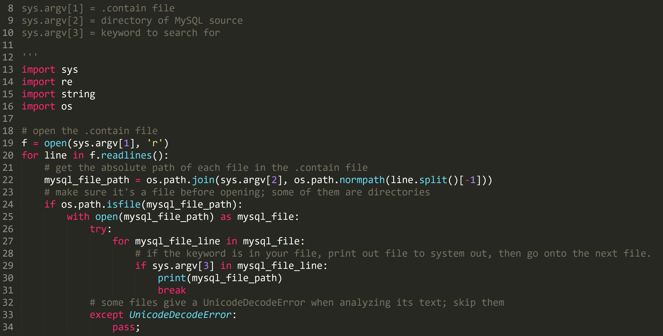
Derivation Process
https://github.com/azkevin/EECS4314/blob/master/A2/a2data.py
Notes:
When we speak about the derivation process, its mainly about how we group each file from the source into each subsystem
The source code has 1000s of files, which makes it difficult to manually group each file
Because of this, our group made a simple python script that helped us.
Without explaining too much of the code, it essentially goes through each file in the .contain file given to us, and searches for a keyword you provide the script

Slide 5
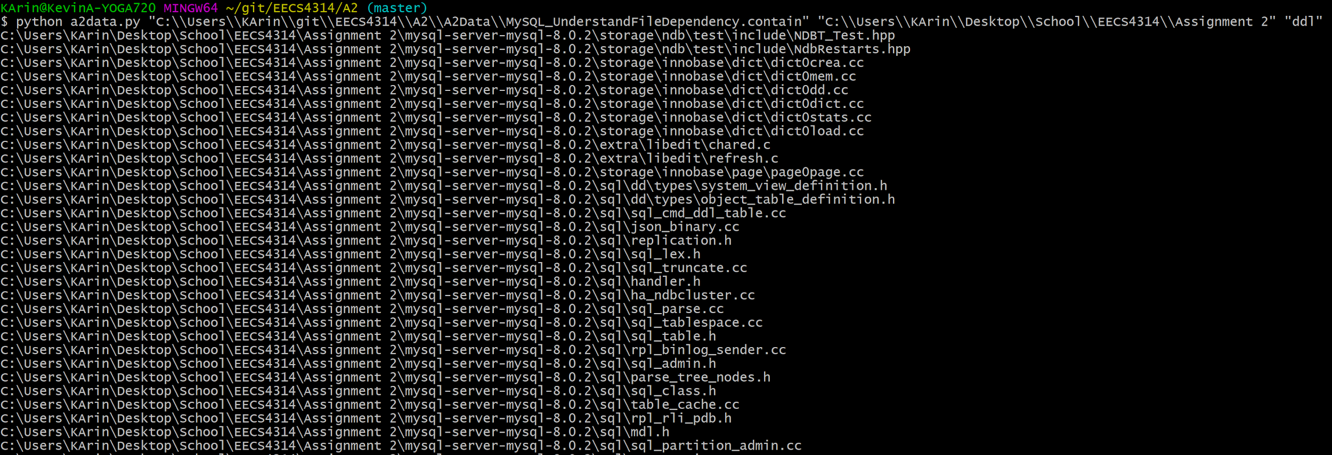
Derivation Process
Derivation Process (Kevin)
https://github.com/azkevin/EECS4314/blob/master/A2/a2data.py
Look for keywords, comments, name of the file, and file directory structure then add relevant files of the subsystem to the .contain file
Notes:
This is how a sample input/ouput would work.
The blue box is the location of the .contain file
The green box is the location of the source code
The cyan box is the keyword we’re searching for. In this example say I'm researching the ddl compiler subsystem, so the keyword I used is “ddl”
The output gives the path of each file containing “ddl”
From there I would look at this list of files and determine from other keywords, comments, name of the class/file, and file directory structure to determine if it belongs to the ddl compiler subsystem.
For example, the files in the red box have a file directory structure stemming from the storage folder. I would deduct that it would most likely belong to the storage engine subsystem rather than the query processing one.
Alternative: Github has a file finder built in on their web app. You can probably use that instead to search using keywords.

Slide 6
System Architecture
Key Findings:
Concrete Architecture reveals that there Exist
Some new dependencies
Two way dependencies between different components and subsystems instead of One way dependencies

Slide 7
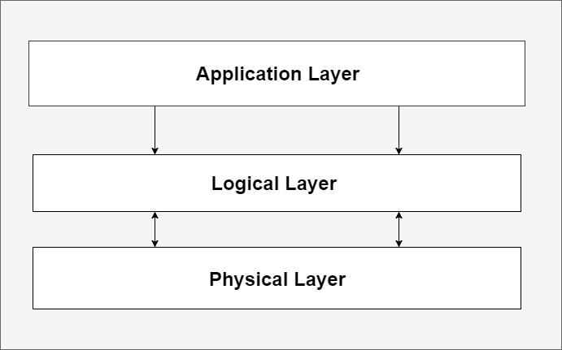
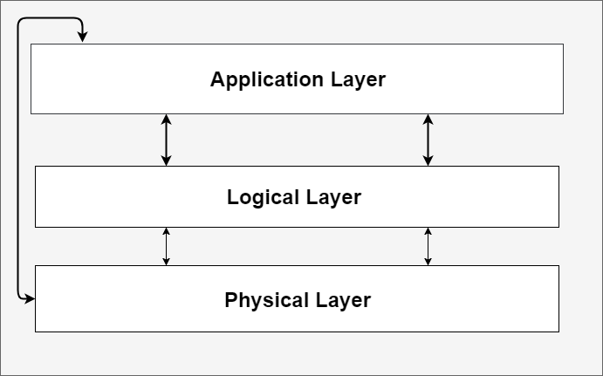
System Architecture
Key Findings:
Simpler Conceptual Architecture VS. Simpler Concrete Architecture

Slide 8
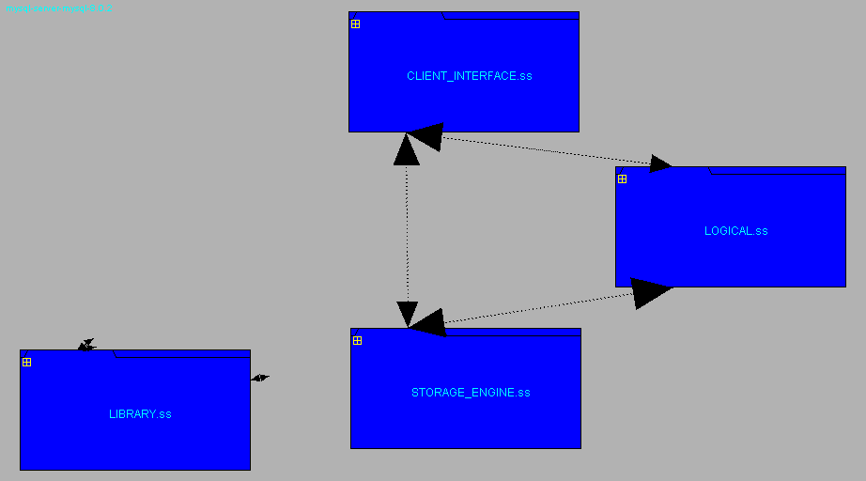

Slide 9
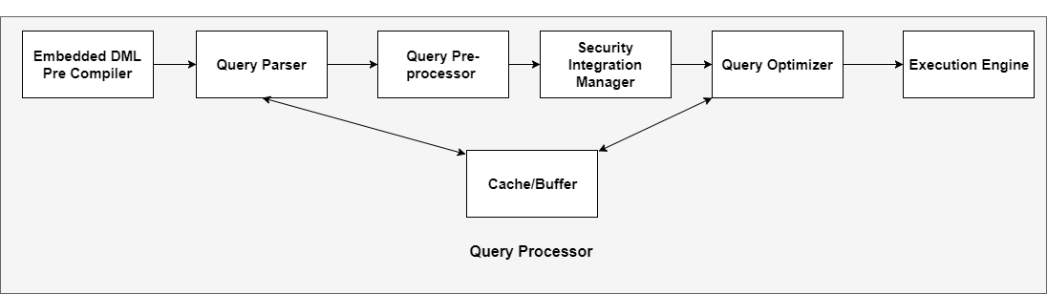
Query Processor Conceptual Architecture

Slide 10
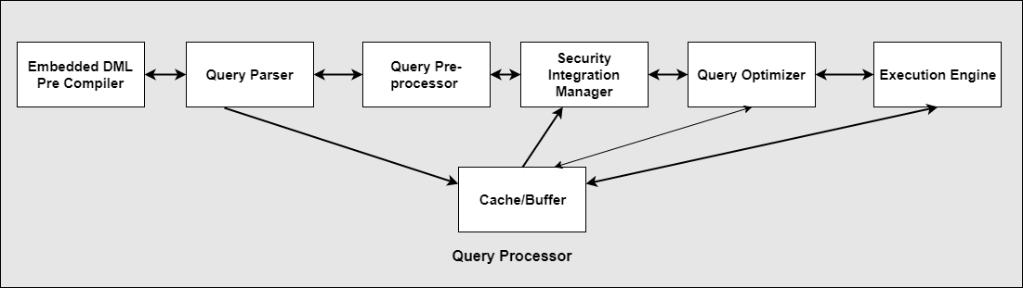
Query Processor Concrete Architecture
Changes are represented as bolded arrows

Slide 11
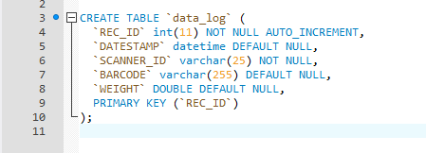
DDL Compiler
Data Description Language (DDL): Syntax to create or alter the structure of the database.
Example SQL Statements:
CREATE
ALTER
DROP
RENAME
TRUNCATE
The DDL Compiler converts these statements into machine/object code for MySQL usage.
Notes:
The first subsystem in our concrete architecture is the DDL Compiler.
Just a brief synopsis of what it does, it converts DDL statements into machine/object code for MySQL to use.
DDL statements are SQL statements to modify or alter the database structure, such as create table, or drop table.

Slide 12
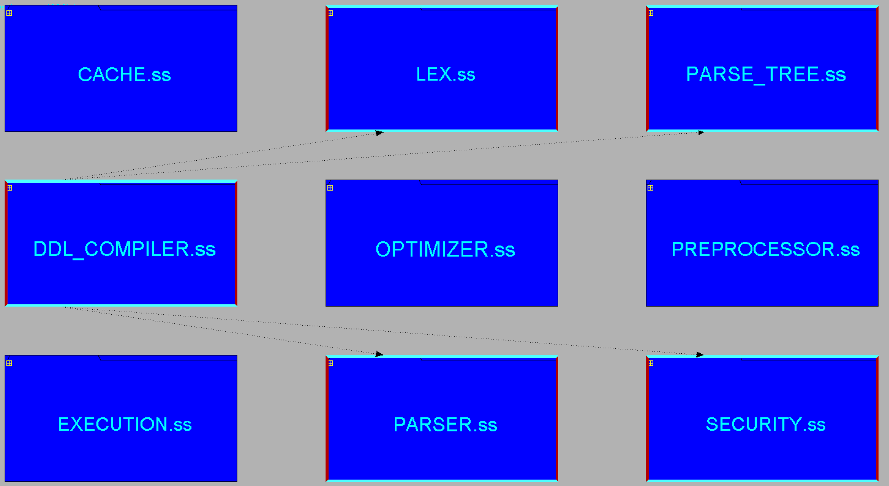
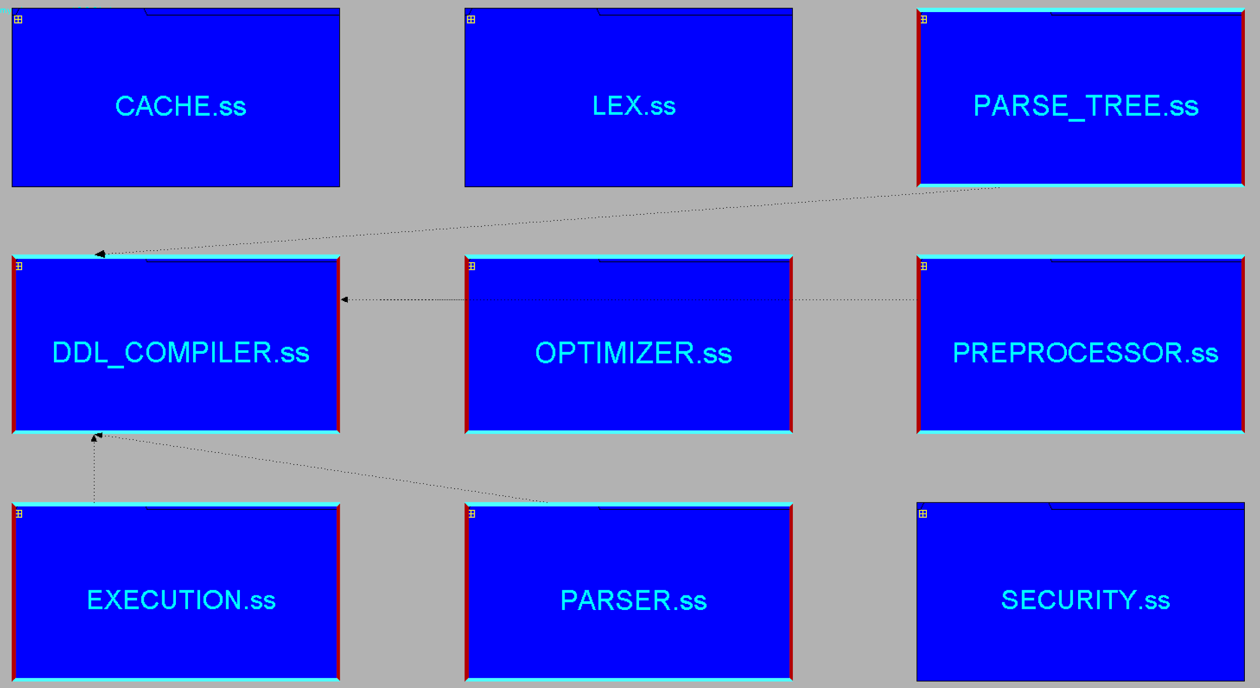
DDL Compiler
Concrete
Conceptual
Notes:
Here is a comparison between the conceptual and concrete architecture of the DDL Compiler.
In our original conceptual diagram we forgot to include the DDL compiler, most likely because we assumed the DML Compiler also included the DDL compiler.
In the concrete, it is a separate subsystem because DDL handles query syntax for creating and managing the database, whilst the DML (Data Manipulation Language) compiler handles query syntax for manipulating the data in the database. (Ex. SELECT)

Slide 13
DDL Compiler
LEX
PARSE_TREE
PARSER
SECURITY
Notes:
The DDL Compiler subsystem has dependencies on the LEX, PARSE_TREE, PARSE, AND SECURITY subsystems.
LEX: Used to read tokens from the parse tree
PARSE_TREE: Used to obtain the proper syntax for SQL statements
PARSER: Used to pass the compiled SQL statements to the parser
SECURITY: Used to ensure the user that has correct permissions to run DDL commands

Slide 14
Query Parser
Interpreter and visitor design patterns.
Conceptual vs concrete architecture.
Parser to other subsystems ( security, DD_compiler, Cache , Parse Tree, LEX, Optimizer).
Other Subsystems to Parser ( Optimizer, Security, DD_compiler , Parse Tree, LEX).
New subsystems.
Notes:
2min: Nisha

Slide 15
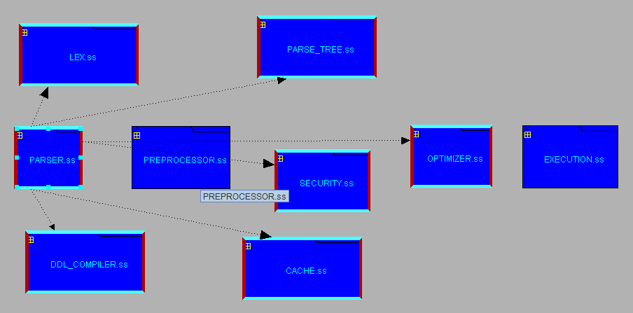
Parser to other systems dependencies

Slide 16
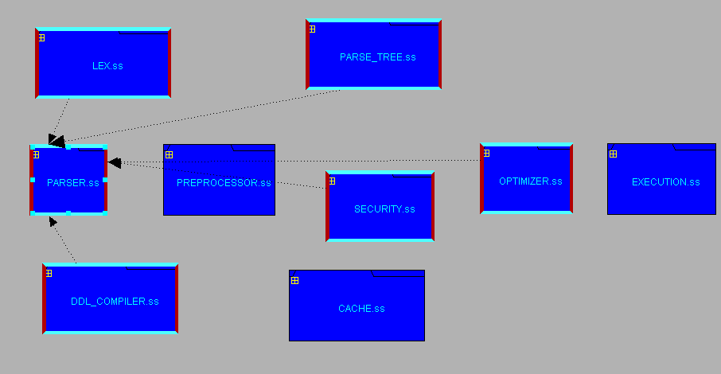
Other systems to Parser dependencies

Slide 17
Query Preprocessor
Performs semantic validation
Verify that the relations and views are in the database schema
Verify that attributes have a corresponding relation specified
Verify attribute types
Parse tree is valid only if it is syntactically and semantically valid
Notes:
2min: Varsha
Performs Semantic Validation
Checks against schema definition:
Are relations and views mentioned in the schme?
Are attributes mentioned in the current scope?
Checks types : Are attribute types correct?
If a parse tree passes syntax and semantic validation, it is called a valid parse tree

Slide 18
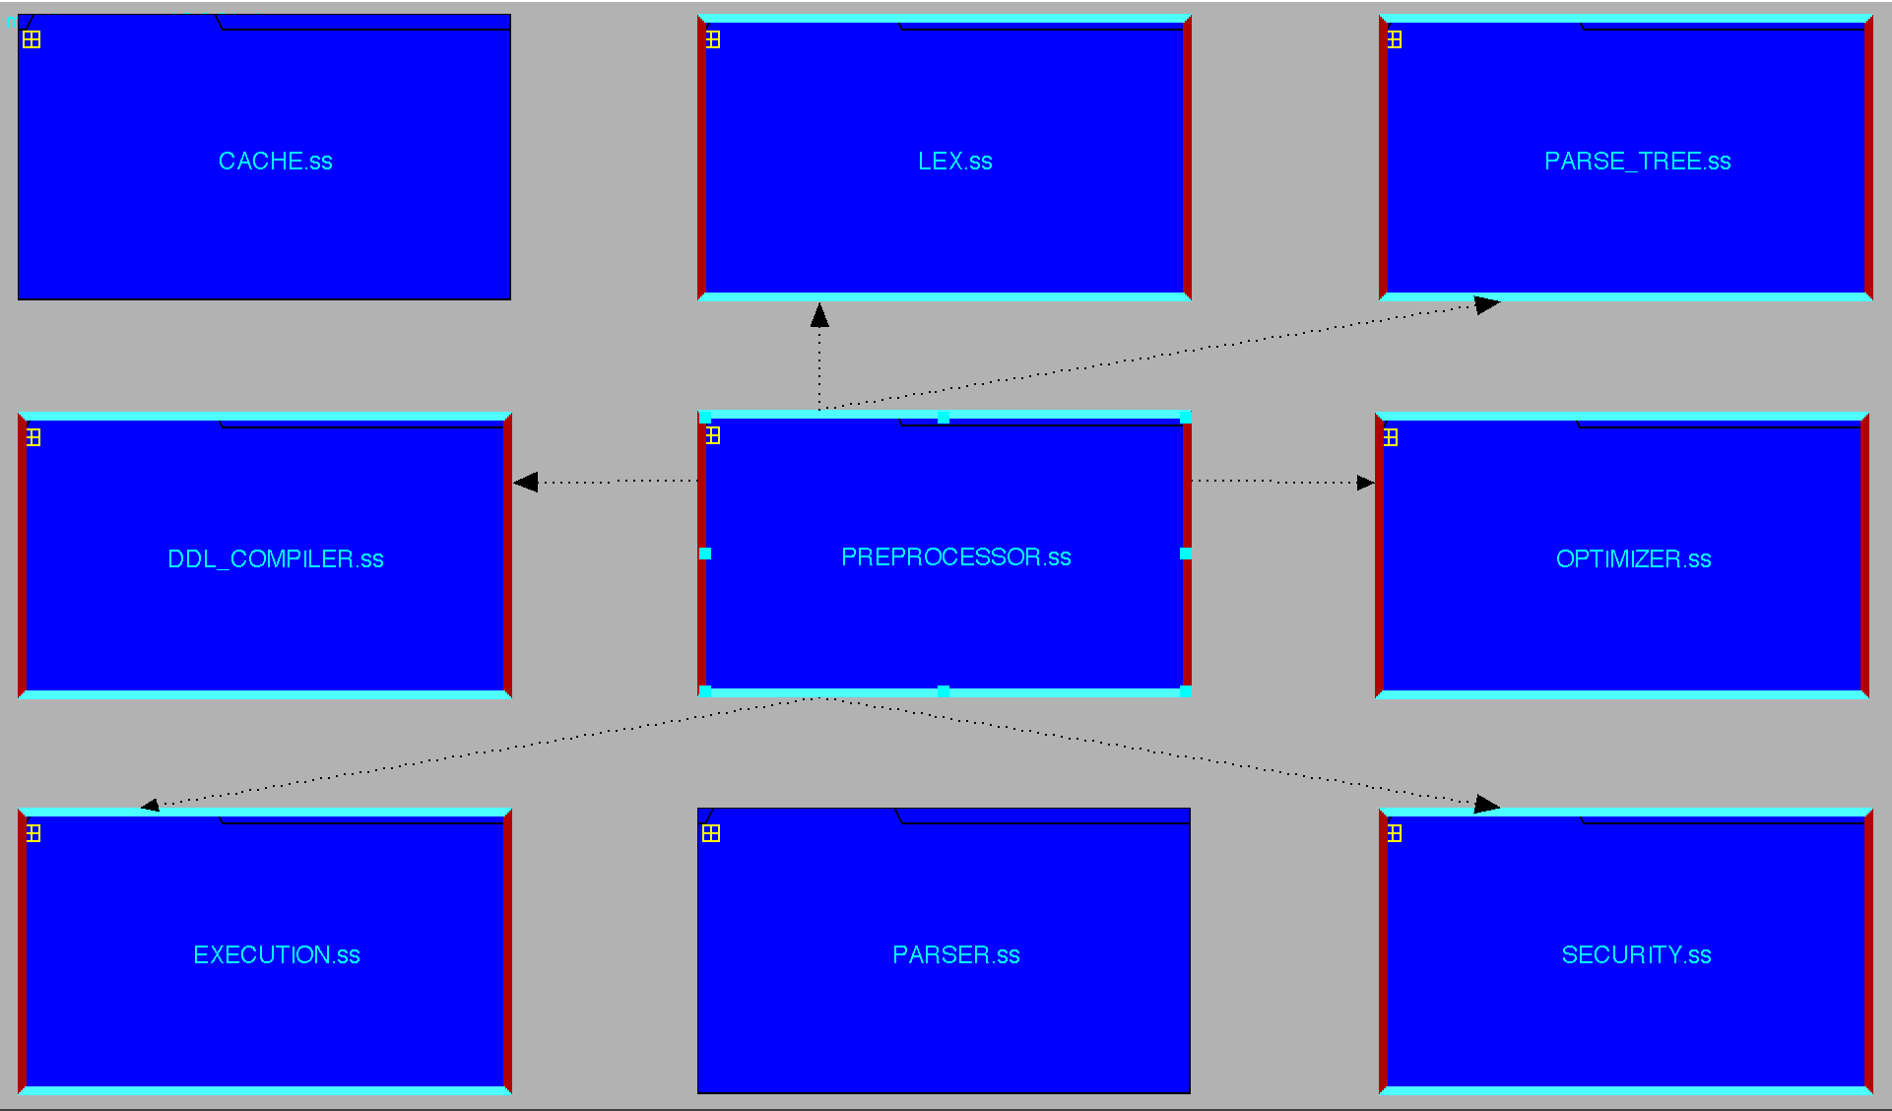
Preprocessor depending on other systems
Concrete
Conceptual

Slide 19
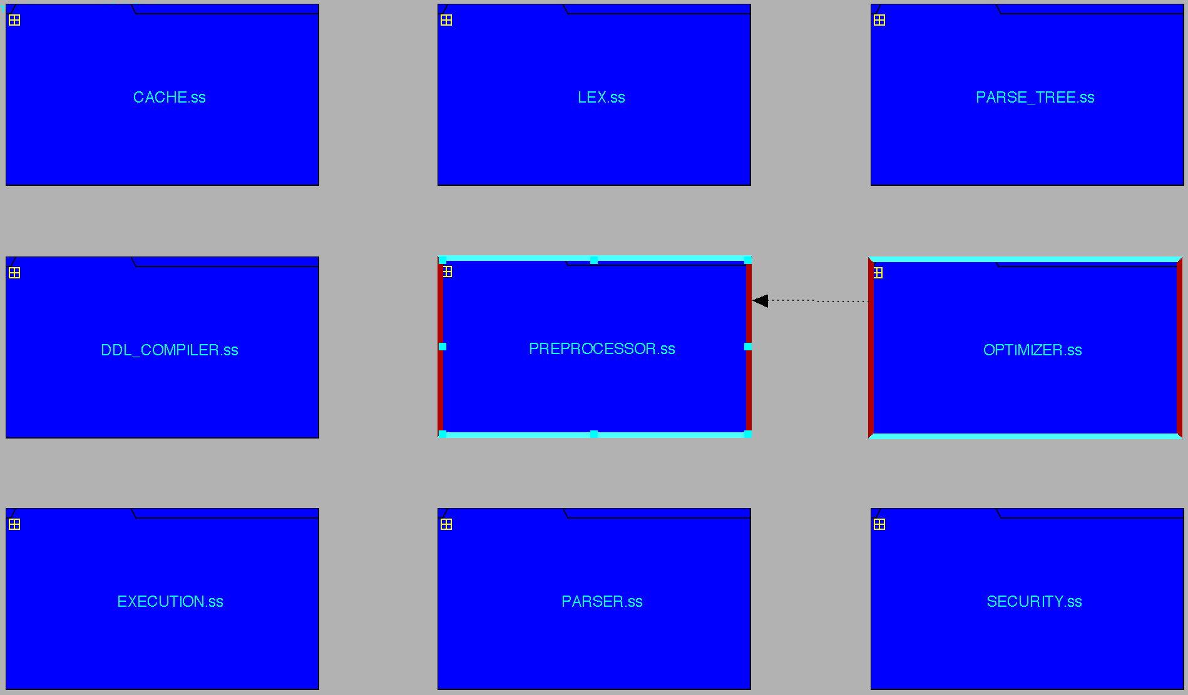
Other Systems depending on Preprocessor
Concrete
Conceptual

Slide 20
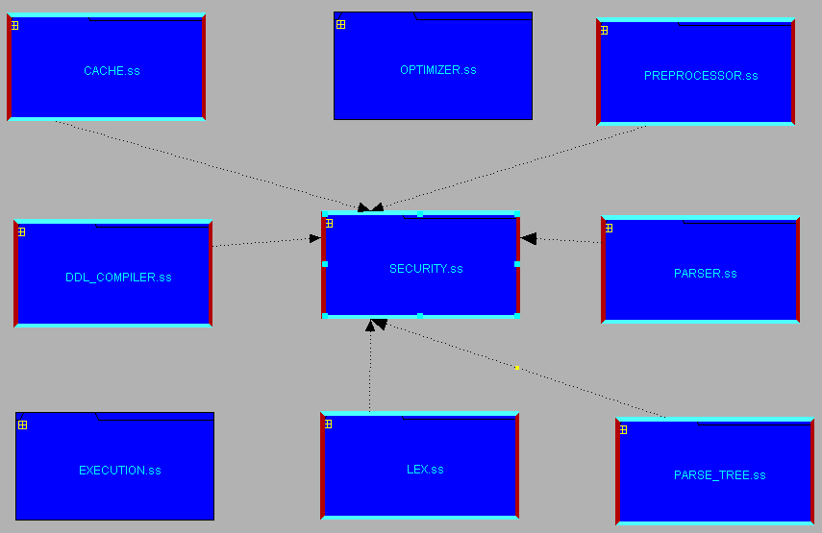
Security Integration Manager
Other Systems Depending on Security
Concrete
Conceptual
Notes:
The security Integration Manager is responsible for checking whether the client has access for the connection they are trying to make and keeps track of table and record privileges.

Slide 21
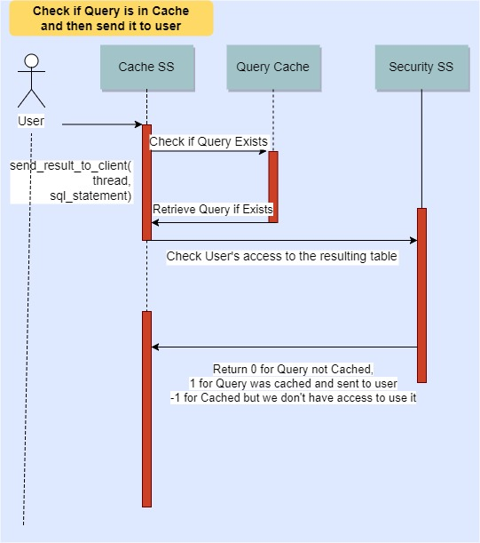
Use Case

Slide 22
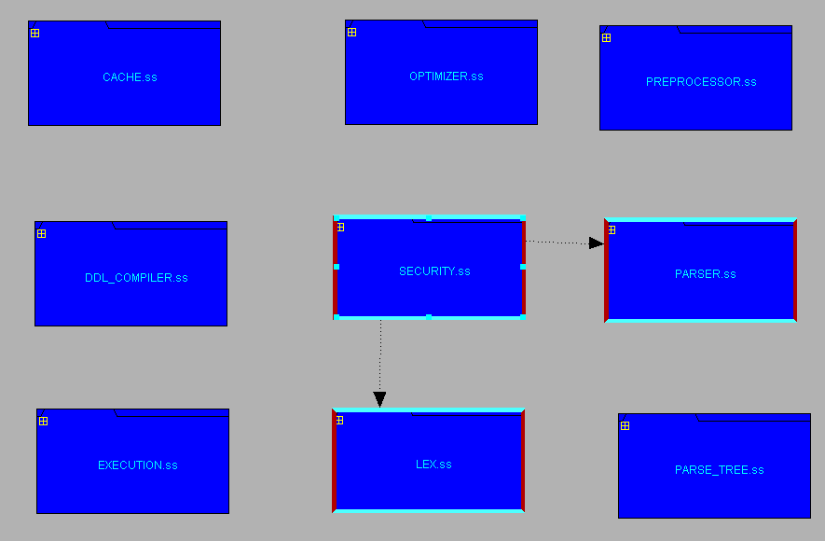
Security Integration Manager
Security depending on other systems
Concrete
Conceptual

Slide 23
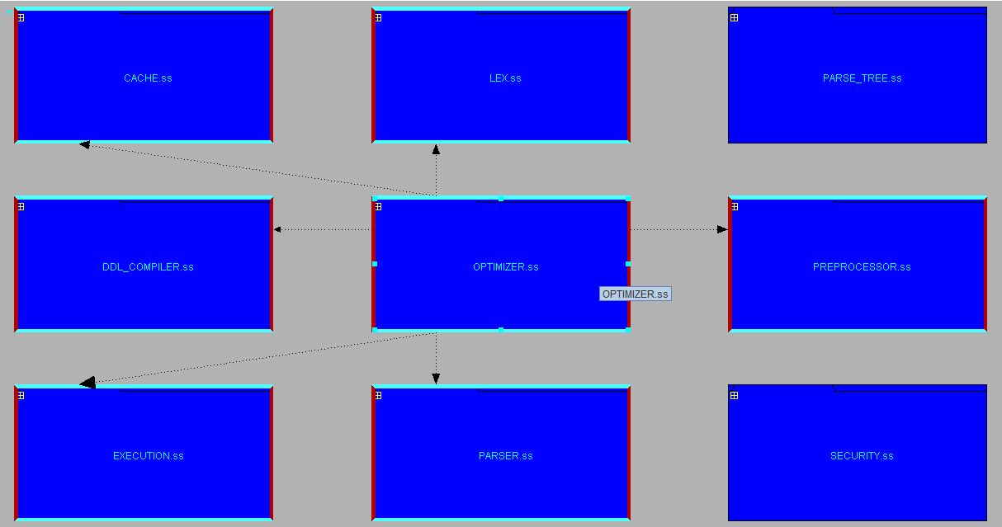
Optimizer to other systems dependencies
Concrete
Conceptual

Slide 24
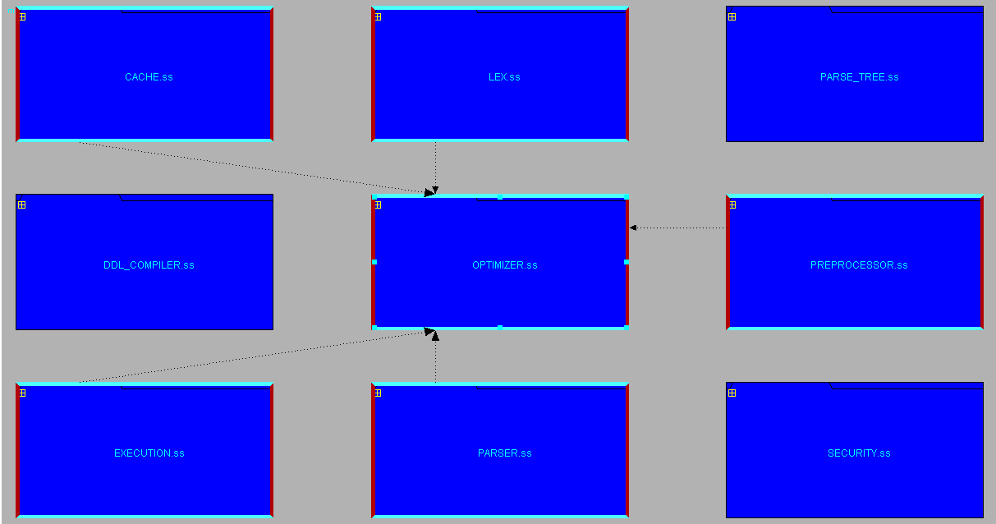
Other systems to Optimizer dependencies
Concrete
Conceptual

Slide 25
Execution Engine
Execution engine to other subsystems dependencies.
Other subsystems to execution engine dependencies.
New subsystems.
Notes:
2min: Nisha

Slide 26
Execution Engine
Execution engine to other subsystems dependencies.
Other subsystems to execution engine dependencies.
New subsystems.
Notes:
2min: Nisha

Slide 27
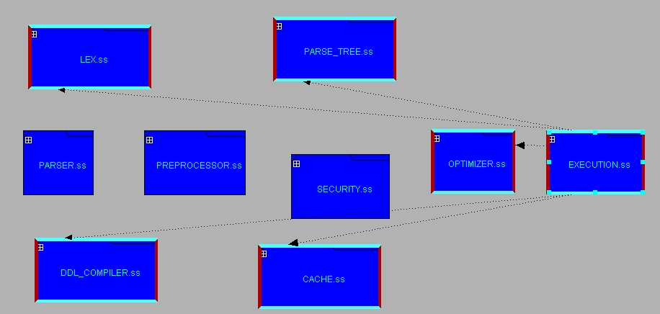
Execution to other subsystems dependencies
Concrete
Conceptual

Slide 28
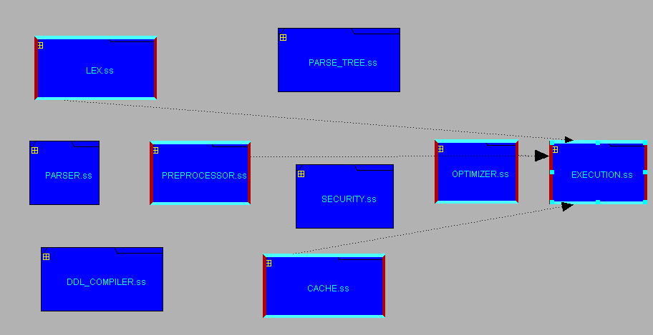
Other subsystems to execution dependencies
Concrete
Conceptual

Slide 29

Conclusions
Notes:
2min: Nisha

Slide 30
Lessons Learned
Lots of Work
Iterative Process
Automation
Scripts
Regex
It is difficult to derive concrete subsystems from looking at the source code and directory structure. Comments and documentation provide little help in understanding the concrete architecture.
Security Integration Manager is called many times throughout the query processing task by different subsystems, as opposed to just once.
Notes:
2min: Nisha

Slide 31
Question Period

